Slide 1

Automatic Genre Classification of Audio Signals
BTP Presentation: Phase 1
Abhinav Singh and Ashna Dhanda
Supervisor: Dr. S.R.M Prasanna
Bachelor of Technology Program,
Electronics and Communication Department,
Indian Institute of Technology,
Guwahati, Assam.

Slide 2
Contents
Why is Music Interesting ?
Music Genres
Related Works
Our Automatic audio genre classification system
Results and Conclusions
Future Work
References

Slide 3
Why Is Music Interesting ?
Our Daily life is highly dependent on information, e.g. in format of texts and multimedia. Immense flow of information makes it hard to find what we are looking for.
Better Content management is the goal of an Automatic Audio description system.
Issues for music information retrieval
    Musical Genre Classification, Music Similarity, Tempo Detection.
    Construction of playlist important
    Navigation through vast quantities of unknown music difficult
    Copyright protection

Slide 4
Music Genre
Musical genres are categories that have arisen through a complex interplay of cultures, artists and market forces to characterize similarities between musicians or compositions and organize music collections.
Need for a taxonomy of genre
    Non-Musical Criteria
    Musical Criteria
Pachet and Cazaly [2] showed that a general agreement on genre taxonomies does not exist.
Weare [1] reports that the manually labeling of hundred thousand songs for Microsoft’s MSN Music Search Engine needed about 30 musicologists for one year.

Slide 5
Music Genre (Continued….)
  9 genres we have considered for our work are:
  Ambient
  Blues
  Classical
  Jazz
  Rap
  Rock
  Electronic
  New Age
  Folk

Slide 6
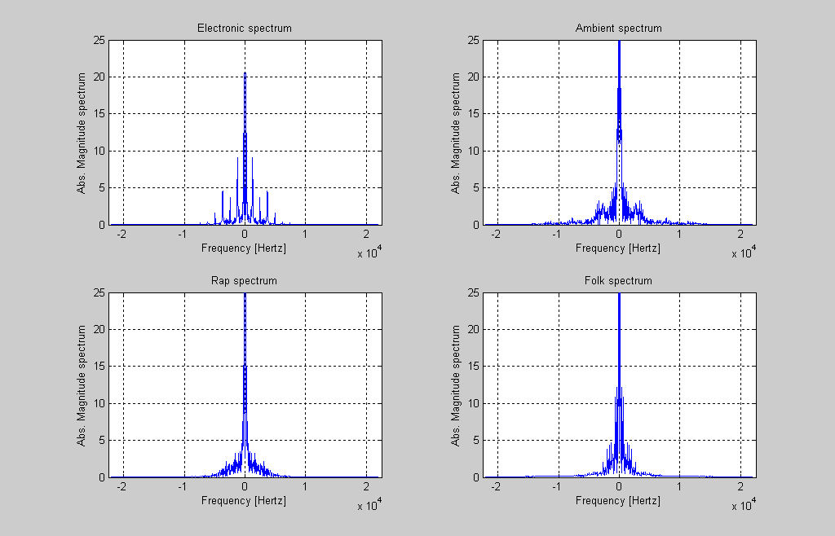
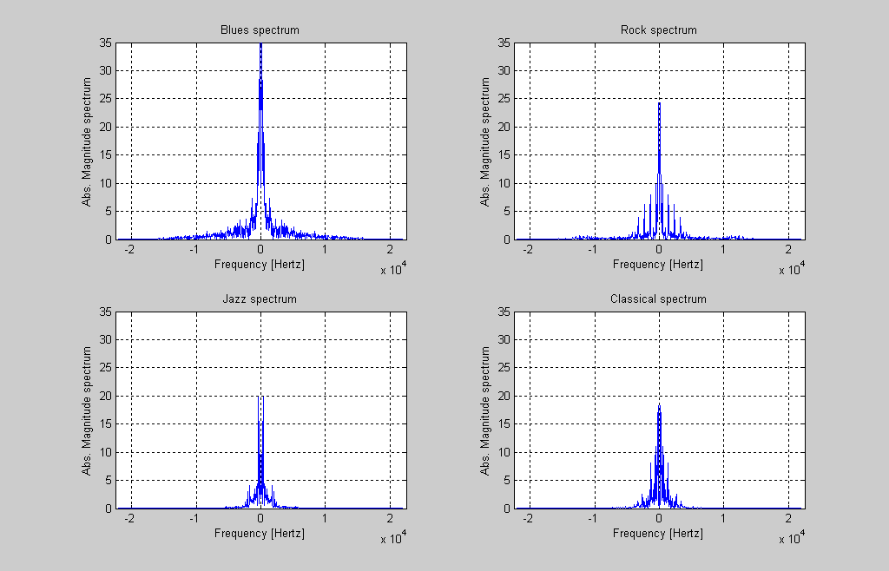
Music Genre (Continued….)
STFT spectrum of audio files from various genres.
Figure1: Electronic,Ambient,Rap,Folk
Figure2: Blues,Rock,Jazz,Classical

Slide 7
Related Works
Following is a general block diagram of a Classification System:
audio file
Feature Extraction
Training
Classification Scheme
Testing
Codebook Database
Comparision
Classified Output

Slide 8
Related Works (Continued….)
Feature Extraction
  Zero Crossing Rate
  RMS
  Loudness
  Low Energy Features
  Linear Prediction Coefficients
  FFT Coefficients
  MFCC Features
  Spectral Centroids
  Spectral Roll-off
  Spectral Flux and Ratio
  Spectral Spread and Flatness
  Wavelets
Typically a 30 sec long audio piece is taken starting 30 sec after the beginning of the piece.
Most approaches focus on timbre modeling based on combination of low- level descriptors.
Analysis window of block size 20 msec and hop size of 10 msec is generally used.
In case of genre classification, it is probable that these precision requirements could be relaxed.
West and Cox [16] used audio samples at 22050 Hz sampling rate and no overlap between the frames without significant loss in classification accuracy.

Slide 9
Related Works (Continued…)
Pattern Classifiers
Unsupervised Algorithms
K-Means
Self Organizing Maps (SOM)
Growing Hierarchal SOM (GHSOM)
Supervised Algorithms
K-Nearest Neighbour (KNN)
Gaussian Mixture Models (GMM)
Support Vector Machines (SVM)
Hidden Markov Models (HMM)
Mixture of Experts (ME)

Slide 10
Automatic Audio Genre Classification System
Feature Extraction
  Segmentation into analysis frames
    Audio excerpts used were sampled at Fs=44.1 KHz, 16-bit resolution and converted to mono signal.
    Signal is analyzed through sliding windows of 23 msec overlapped by 50%.
  Texture Windows
    Frames of 23 msec are used for STFT analysis.
    Some more integration is required to build more robust features. Not only does it reduce further computation but it is also more perceptually relevant.
    Tzanetakis [17] studied texture window of 1 second are a good compromise since no significant gain in classification accuracy is obtained by taking larger window while the accuracy decreases as the window is shortened.
    Consequently, we used a simple 1 second texture window.

Slide 11
Mel Frequency Cepstral Coefficients (MFCC’S)
Dominant feature used in speech and audio processing.
Perceptually motivated featured from Mel-Scale.
Mp3 to wav converter
Windowing (Hamming) Block Size = 23 msec Hop Size = 10 msec
DFT
.mp3 file
20 mfcc’s per frame
40 Mel Filter Banks
IDFT
TEXTURE
WINDOW
MFCC mean and variance
……….……..

Slide 12
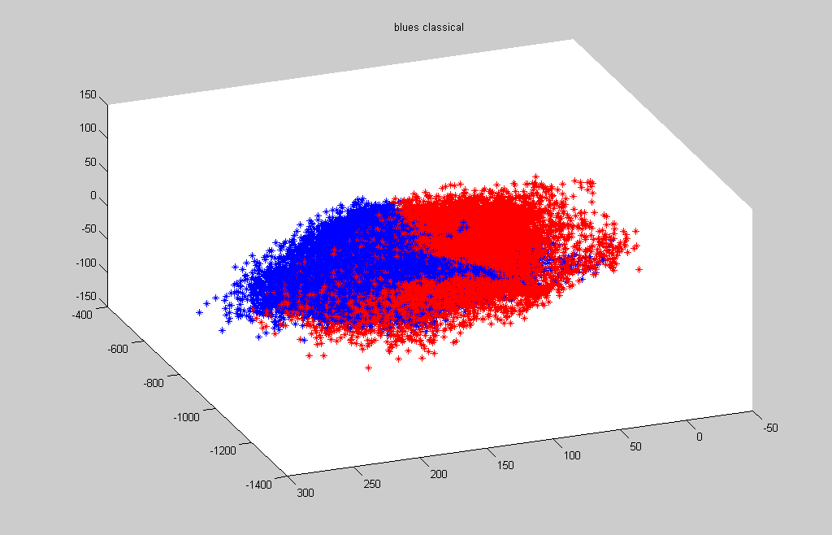
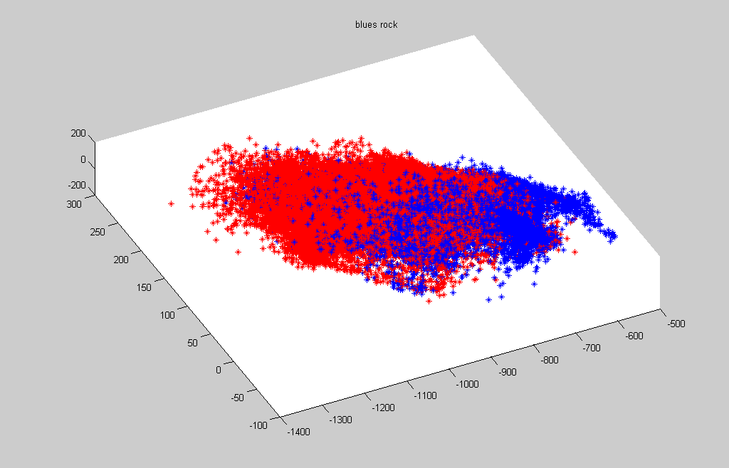
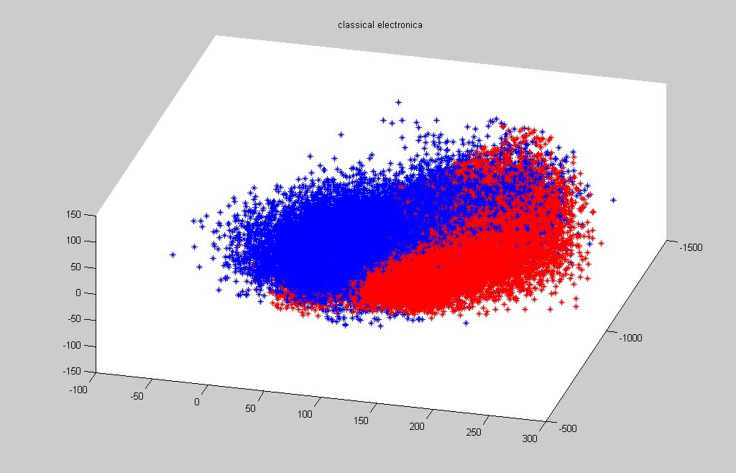
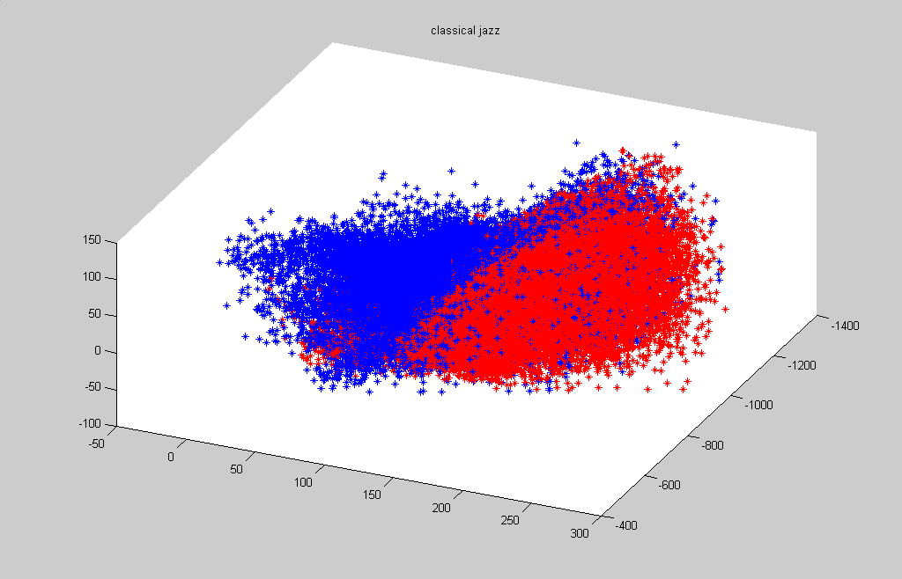
MFCC’s (Continued….)
Blues vs. Classical
Blues vs. Rock
Classical vs. Electronica
Classical vs. Jazz

Slide 13
Log-Compressed Energy
Energy in 7 energy bands is calculated.
Each energy band covers roughly an octave.
Mp3 to wav converter
Windowing (Hamming) Block Size = 23 msec Hop Size = 10 msec
DFT
.mp3 file
Mean and Variance of Log Compressed energy
Log Compressed energy computation
7 Log compressed energy values
TEXTURE
WINDOW
…………

Slide 14
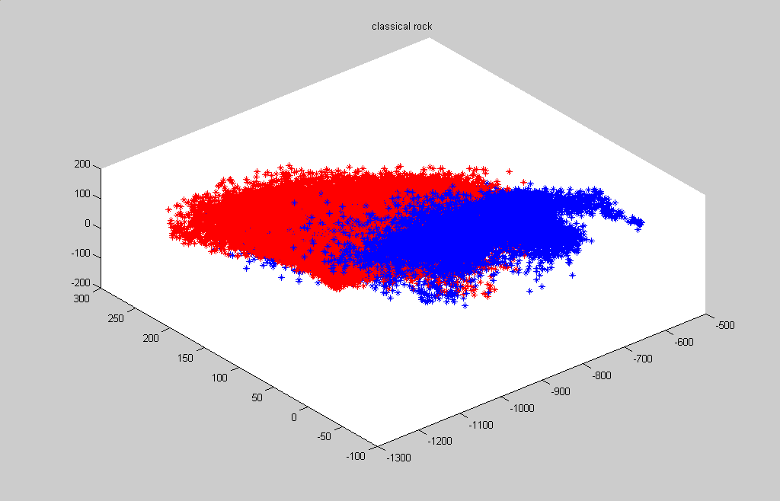
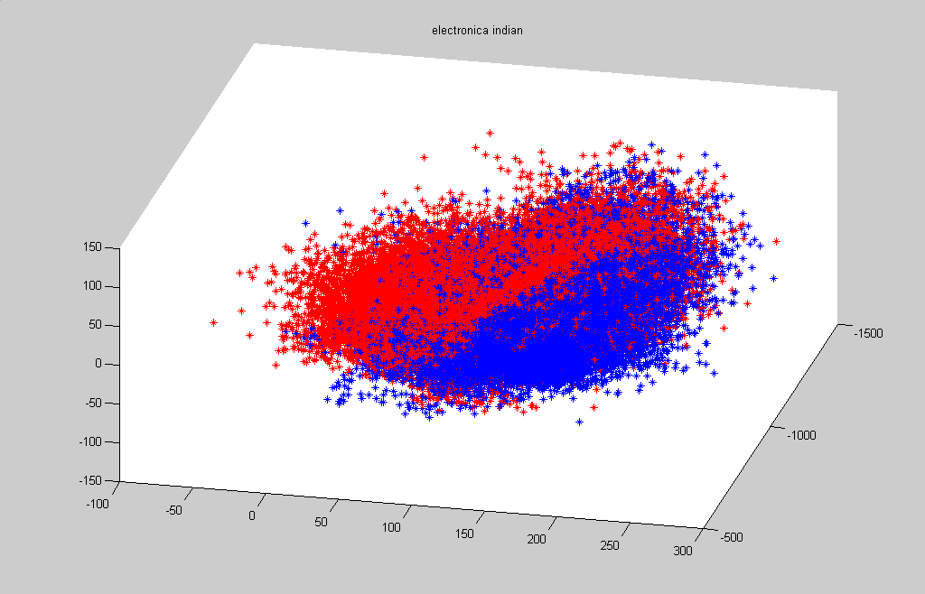
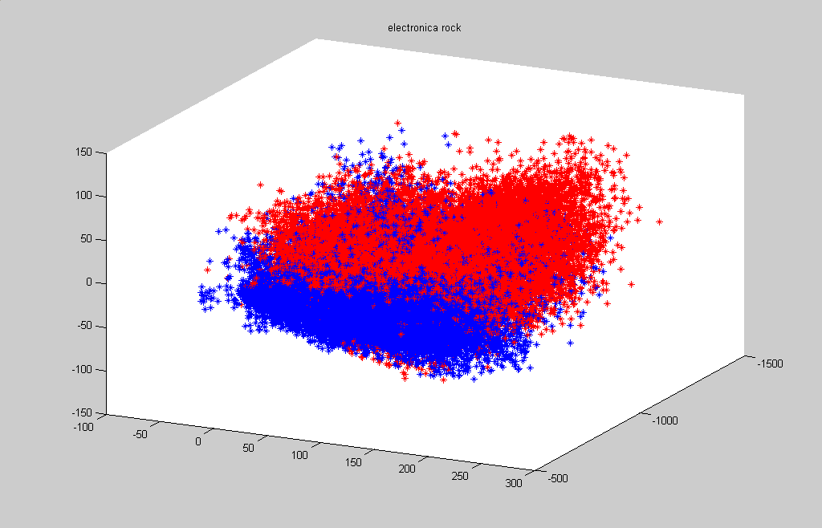
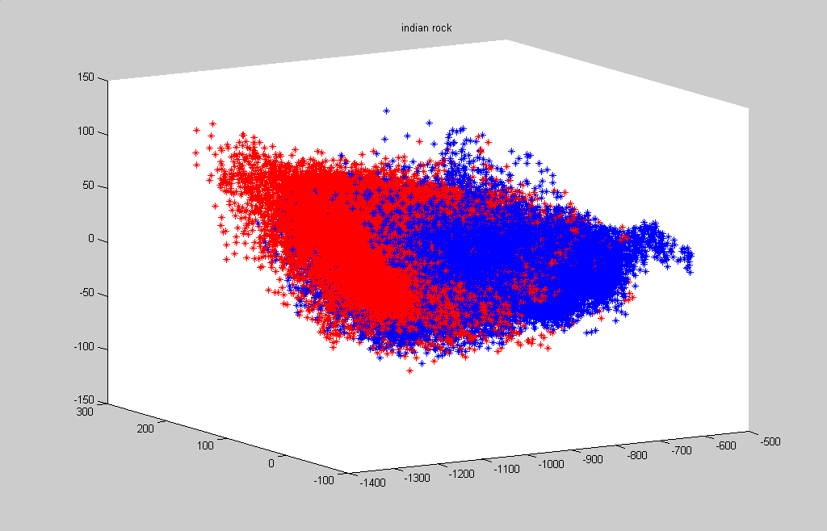
Log-compressed Energy (Continued….)
Electronica vs. Ambient
Classical vs. Rock
Electronica vs. Rock
Ambient vs. Rock

Slide 15
Vector Quantization
Vector Quantization (VQ) is a concatenation of binary-split and K-means algorithm.
Feature extraction step gave two set of feature vectors for each genre respectively. Feature vectors are saved as genre.mfcc and genre.energy.
Dimension of test feature vector matrices are 43,000 x 20 and
43,000 x 7 respectively for mfcc and energy features for each genre.
VQ gave us 128 codebook vectors corresponding to each feature file
Codebooks are saved as genre.mfcc.codebook and genre.energy.codebook. Size of codebook matrices is 128 x 20 and 128 x 7 respectively for each genre.
While testing similar features are extracted. For each audio excerpt we get approximately 30 mfcc and energy feature vectors. Finally on basis of minimum Euclidean distance from codebook, we annotate the test song to the corresponding genre.

Slide 16
Results
Confusion Matrix Obtained using MFCC as feature vectors
 | Am | Blu | Cla | Ele | Fol | Jaz | Nag | Rap | Roc
Am | 64 | 0 | 12 | 6 | 6 | 6 | 4 | 2 | 0
Blu | 0 | 76 | 0 | 6 | 2 | 6 | 0 | 0 | 10
Cla | 0 | 0 | 96 | 0 | 0 | 0 | 2 | 2 | 0
Ele | 0 | 0 | 2 | 94 | 0 | 2 | 2 | 0 | 0
Fol | 0 | 2 | 6 | 0 | 88 | 2 | 2 | 0 | 0
Jaz | 0 | 0 | 0 | 6 | 0 | 88 | 0 | 6 | 0
Nag | 2 | 3 | 15 | 0 | 3 | 10 | 67 | 0 | 0
Rap | 0 | 1 | 0 | 5 | 0 | 0 | 0 | 90 | 4
Roc | 0 | 0 | 0 | 2 | 2 | 5 | 0 | 6 | 85
Am=Ambient, Blu=Blues, Cla=Classical, Ele=Electronic, Fol=Folk, Jaz=Jazz, Nag=New-Age, Roc=Rock

Slide 17
Results
Confusion Matrix Obtained using Energy as feature vectors
 | Am | Blu | Cla | Ele | Fol | Jaz | Nag | Rap | Roc
Am | 74 | 0 | 10 | 4 | 4 | 4 | 4 | 0 | 0
Blu | 0 | 80 | 0 | 4 | 0 | 6 | 0 | 0 | 10
Cla | 0 | 0 | 96 | 0 | 0 | 0 | 0 | 4 | 0
Ele | 0 | 0 | 0 | 96 | 0 | 0 | 4 | 0 | 0
Fol | 0 | 2 | 4 | 0 | 92 | 0 | 2 | 0 | 0
Jaz | 0 | 0 | 0 | 4 | 0 | 90 | 0 | 6 | 0
Nag | 3 | 0 | 13 | 0 | 2 | 7 | 74 | 0 | 0
Rap | 0 | 2 | 0 | 5 | 0 | 0 | 0 | 90 | 3
Roc | 0 | 0 | 0 | 5 | 0 | 1 | 0 | 6 | 88
Am=Ambient, Blu=Blues, Cla=Classical, Ele=Electronic, Fol=Folk, Jaz=Jazz, Nag=New-Age, Roc=Rock

Slide 18
Conclusion
The obtained accuracy of 86.77% and 83.11% is encouraging and comparable to other state-of-the-art algorithm evaluated yearly at the MIREX contest (the annual audio processing algorithm contest).
By analyzing carefully the confusion matrix, one can notice that classification error make sense: for example, on the MAGNATUNE dataset, 20.59% of the punk excerpts are classified as rock. There is indeed a clear overlap between these two genres and the misclassified examples may have been probably better described as belonging to both classes.
From confusion matrix it is also evident that Log-Compressed energies give better representation of the audio signal as compared to MFCC’S feature vectors.
Overall we suggest use of both features for audio classification. MFCC’S give a representation of musical timbre which is equally important as Log-Compressed energy which gives better representation of perception model for audio files.

Slide 19
Future Direction
Exploring other feature vectors like DWT and Spectral Centroid.
Exploring temporal features of the audio files, as tempo of the song is an important facet of audio signals.
Use of better classification schemes like GMM,SVM and HMM.
Automatic Playlist Generation System
Integrate present approach in building of an Automatic playlist generation system. This system will take an input query song from the user and help him achieve a playlist of songs, where songs in the playlist will be musically identical to his input query song.

Slide 20
References
[1] R. Dannenberg, J. Foote, G. Tzanetakis, and C. Weare, “Panel: new directions in music information retrieval,” Proc. Int. Computer Music Conf., Habana, Cuba, Sept. 2001.
[2] F. Pachet and D. Cazaly, “A taxonomy of musical genres,” Proc. Content-Based Multimedia Information Access (RIAO), Paris, France, 2000.
[3] F. Pachet, J.J. Aucouturier, A. La Burthe, A. Zils, and A. Beurive, “The cuidado music browser: an end-to-end electronic music distribution system,” Multimedia Tools Applicants., 2004, Special Issue on the CBMI03 Conference, Rennes, France, 2003.
[4] G. Peeters, “A large set of audio features for sound description (similarity and classification) in the CUIDADO project,” CUIDADO I.S.T. Project Rep., 2004.
[5] G. Tzanetakis and P. Cook, “Musical genre classification of audio signals,” IEEE Trans. Speech Audio Processing, vol. 10, no. 5, pp. 293– 302, July 2002.
[6] A. Meng, P. Ahrendt, and J. Larsen, “Improving music genre classification by short-time feature integration,” Proc. 6th Int. Symp. Music Information Retrieval, London, UK, 2005, pp. 604–609.
[7] K. West and S. Cox, “Finding an optimal segmentation for audio genre classification,” Proc. 6th Int. Symp. Music Information Retrieval, London, UK, 2005, pp. 680–685.

Slide 21
References (Continued….)
[8] N. Scaringella and G. Zoia, “On the modeling of time information for automatic genre recognition systems in audio signals,” Proc. 6th Int. Symp. Music Information Retrieval, London, UK, 2005, pp. 666–671.
[9] E. Gomez, A. Klapuri, and B. Meudic, “Melody description and extraction in the context of music content processing,” J. New Music Res., vol. 32 no. 1, 2003.
[10] A. Klapuri, “Multiple fundamental frequency estimation based on harmonicity and spectral smoothness,” IEEE Trans. Speech Audio Processing, vol. 11, no. 6, pp. 804–816, 2003
[11] A. Berenzweig, D. Ellis, and S. Lawrence, “Using voice segments to improve artist classification of music,” Proc. AES 22nd Int. Conf. Virtual, Synthetic Entertainment Audio, 2002.
[12] M. Mandel and D. Ellis, “Song-level features and support vector machines for music classification,” Proc. 6th Int. Symp. Music Information Retrieval, London, UK, 2005, pp. 594–599.
[13] H. Soltau, T. Schultz, M. Westphal, and A. Waibel, “Recognition of music types,” Proc. IEEE Int. Conf. Acoustics, Speech Signal Processing (ICASSP), Seattle, WA, USA, 1998, vol. II, pp. 1137–1140
[14] N. Casagrande, D. Eck, and B. Kegl, “Geometry in sound: a speech/music audio classifier inspired by an image classifier,” Proc. Int. Computer Music Conf. (ICMC), 2005.

Slide 22
References (Continued….)
[15] A. Flexer, E. Pampalk, and G. Widmer, “Novelty detection based on spectral similarity of songs,” Proc. 6th Int. Symp. Music Information Retrieval, London, UK, 2005, pp. 260–263.
[16] K. West, S. Cox, “Features and classifier for the automatic classification of musical audio signals”, Proc. Of the 5th Int. Conf. on Music Information Retrieval (ISMIR), Barcelona, Spain, 2004.
[17] G. Tzanetakis, P. Cook, “Musical genre classification of audio signals”, IEEE Transactions on Speech and Audio Processing, Vol. 10, No. 5, July 2002.
[18] N. Scaringella, G. Zoia, “On the modeling of time-information for automatic genre recognition systems in audio signals”, Proc. of the 6th Int. Conf, on Music Information Retrieval, London, UK, 2005.
[19] L. Rabiner, B.H. Juang, Fundamentals of speech recognition, Englewood Cliffs, NJ, Prentice-Hall, 1993.
[20] J.J. Aucouturier, F. Pachet, “Improving timbre similarity: how high’s the sky?”, Journal of Negative Results in Speech and Audio Sciences, 2004.
[21] http://www.music-ir.org/
[22] http://www.magnatune.com

